Slide 1
SECLZG544 (S1-25)
Agile Software Processes
Contact Session: 02
J A Gokhale

Slide 2
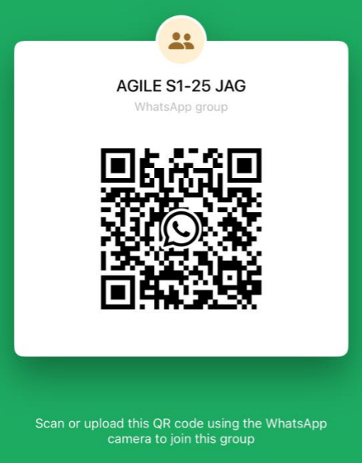
You can join my unofficial WhatsApp group
A. Follow this link to join my WhatsApp group:
https://chat.whatsapp.com/Ia3Do0Bd258HLlCpqHL9bj
B. Or scan the QR Code to join:

Slide 3
Disclaimer
The slides presented here are obtained / extracted from the authors of the prescribed books and from various other subject contributors.
I hereby thank and acknowledge all the contributors for their material and inputs.
I have added and modified a few slides to suit the requirements of the course.

Slide 4
Module 2: Agile Software Development

Slide 5
Module 2 Topics
Topic 1: Iterative and Incremental Approaches
Topic 2: Popular Agile Methods
Ref: T1-Chap5 ; T2-Chap4

Slide 6
Topic 1: Iterative and Incremental Approaches

Slide 7
Project Life Cycle Methods

Slide 8
Lifecycle of a Project
The sequence of actions that must be performed to build a software system
Ideally thought to be a linear sequence: plan, design, build, test, deliver
This is the waterfall model
Realistically an iterative process
Iterative, Incremental, Agile Process

Slide 9
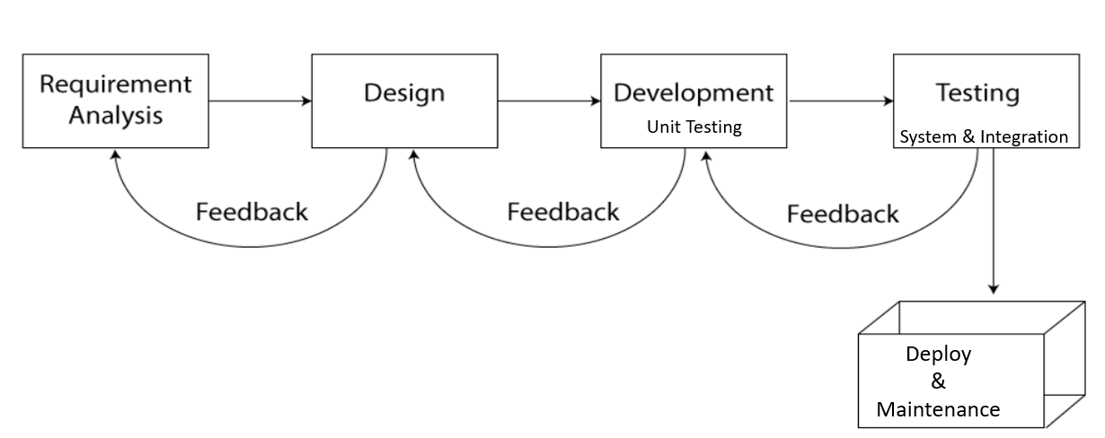
Predictive Project Development Life Cycle (Fully Plan-Driven aka Waterfall)
A more traditional approach, with the bulk of planning occurring upfront, then executing in a single pass; a sequential process
Requirements/Scope is fixed at the start
Single delivery
Goal: Manage Cost
Minimal feedback changes
Team is matured in estimation, technology etc.. (specialized teams working at every stage)
Project governance model exists
Don’t expect long feedback cycle, If this happens, this lifecycle not suitable for the project

Slide 10
Iterative & Incremental Project Development Life Cycle
Both methods aim to enhance the development process, but differ in how they handle the repetition of work and the delivery of the project features / components.
Advantages:
  Early increments act as a prototype to help elicit requirements for later increments
  Lower risk of overall project failure
  The highest priority system services tend to receive the most testing
Iterative: The Iterative model involves repeating cycles of development, allowing for continuous improvement as the project evolves. It is flexible and adaptive to changes. One time product delivery. | Incremental: The incremental model focuses on delivering the software in smaller, functional parts, building upon each increment. Every part is ready to use.

Slide 11
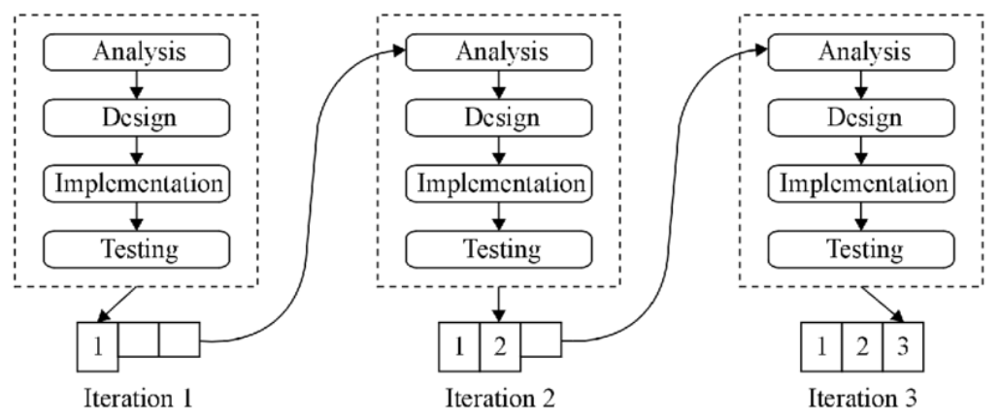
Iterative & Incremental Project Development Life Cycle
Incremental
Increments of software delivered

Slide 12
Iterative Approach
Iterative development is when an attempt is made to develop a product with basic features, which then goes through a refinement process successively to add to the richness in features.
Goal: Correctness of Solution
Repeat until Correct
Show and receive feedback
Add richness or features
Single Final Delivery
Deliver result at the end of each iteration.
Result may not be usable
E.g. 1 year project divided into 3 to 4 iterations
Ex: Developing a Website
Develop a prototype of the Website with basic functionality
Demo to Customer and receive feedback
Add to the richness or feature to the product in subsequent iteration

Slide 13
Incremental Approach
In an incremental approach, one aims to build pieces of program/product that is complete in features and richness. Product increment is usable.
In this case, each functionality is built to its fullest and additional functionalities are added in an incremental fashion. Responsive to user/ customer requirement changes & recommendations.
Example: You can compare this to a visit to restaurant. You get served starters first and on completion of its main course and then dessert. You get served incrementally and you consume it.

Slide 14
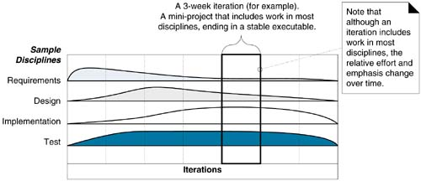
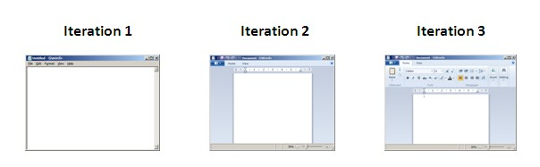
Incremental iterations..
Viewing an iteration as a self-contained mini-project, activities in many disciplines (requirements analysis, design, implementation, testing, and so on) occur within an iteration.

Slide 15
Early Iterative Approaches
Spiral
  A combination of iterative and incremental model with a strong focus on risk analysis
RUP (Rational Unified Process)
  It’s use-case driven, architecture-centric, and iterative methodology. It is not a rigid methodology but a tailorable framework that teams can adapt to their specific project needs

Slide 16
The Spiral Approach
The Spiral Model is a risk-driven software development approach that combines iterative development with systematic risk management.
It emphasizes early identification and resolution of risks, making it suitable for high-risk project
Ideal for large, complex projects where requirements may evolve over time.
It visualizes development as a series of loops or spirals.
  Each loop represents a phase in the development cycle: Planning, Risk Analysis, Engineering, and Evaluation

Slide 17
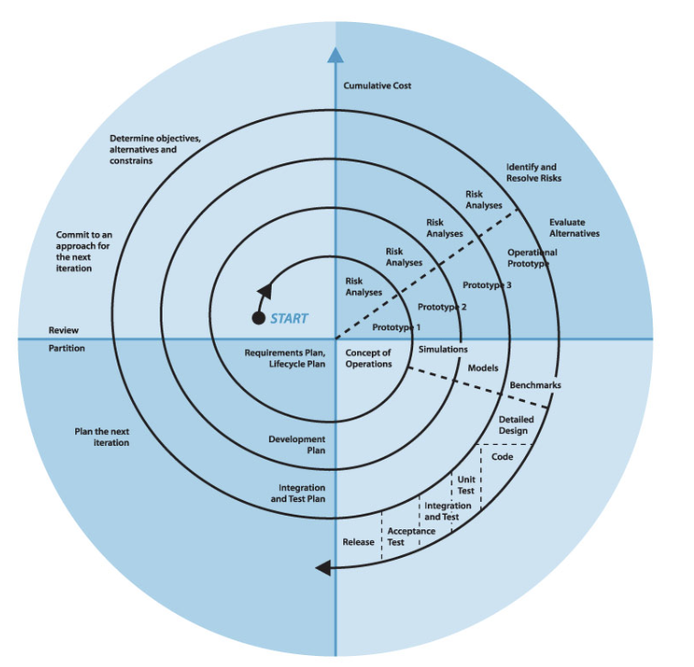
The Spiral Approach
Four Quadrants of Each Spiral
  Planning: Define objectives, gather requirements, and explore alternatives.
  Risk Analysis: Identify and assess risks, then develop strategies to mitigate them.
  Engineering: Design, build, and test the software incrementally.
  Evaluation: Review progress, get feedback, and decide whether to continue or revise.
Planning
Risk Analysis
Evaluation
Engineering

Slide 18
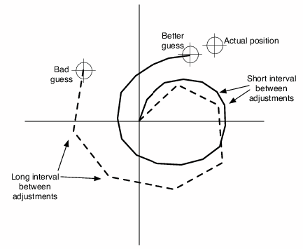
The Spiral Approach
Iteration fosters adjustments to requirements considering the associated risk
Helps ‘close’ the gap between the need and build
Adjustment interval is important

Slide 19
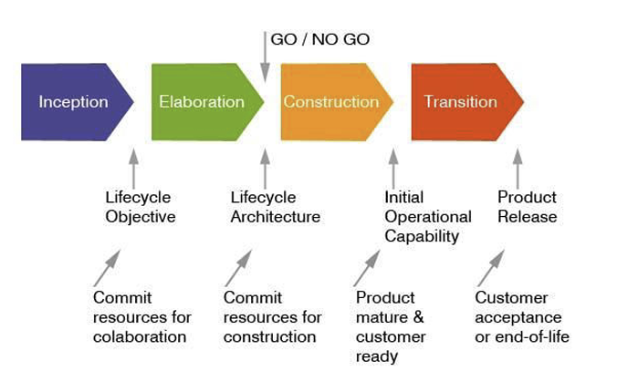
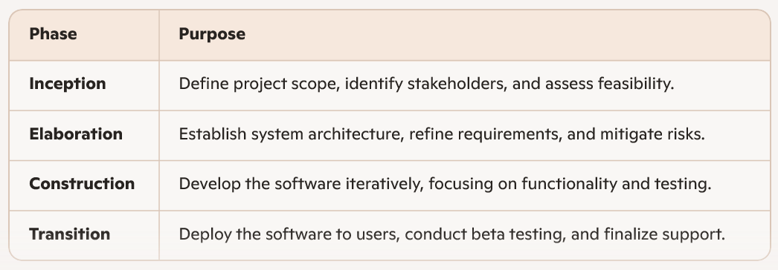
The RUP Approach
It is use-case driven, architecture-centric, and iterative where development happens in cycles with continuous refinement.
It divides the development cycle into 4 major phases, each with specific goals and deliverables.

Slide 20
The RUP Approach
RUP is guided by six best practices:
Develop iteratively to manage risk and adapt to change.
Manage requirements systematically.
Use component-based architecture for scalability and reuse.
Model visually using UML for clarity.
Verify quality continuously through testing.
Control changes with configuration and change management

Slide 21
The RUP Approach
RUP is UML-centric; it uses Unified Modeling Language as the standard notation for all models.
UML provides a visual and standardized way to represent system architecture, behavior, and interactions.
Model | Purpose & Artifacts
Use case model | Captures functional requirements from user's perspective. Use case Diagrams
Analysis model | Refines use cases into system-level requirements and identifies key classes and interactions. Class diagrams, sequence diagrams.
Design model | Specifies the system architecture and design decisions. Class diagrams, component diagrams
Implementation model | Maps design elements to code and organizes the software into packages and components. Component diagrams.
Deployment model | Describes the physical deployment of software on hardware. Deployment diagrams.
Business model | Understands the business context and processes that the system supports. Activity diagrams, business use-case diagrams.
Test model | Defines test cases and procedures to validate system behavior. Sequence diagrams, state diagram, test scripts

Slide 22
Quick Quiz CS2-1
Submit your response using this form

Slide 23
Topic 2: Popular Agile Methods

Slide 24
Client Driven Iterative method
The choice of features for the next iteration comes from the client—whatever they perceive as the highest business value to them.
In this way, the client steers the project, iteration by iteration, requesting the features that they currently think are most valuable.
The customer adaptively plans the choice for the next iteration, shortly before it starts, based on their latest insight, rather than speculatively at the start of the project.
The customer has ongoing control and choice, as fresh information arises.

Slide 25
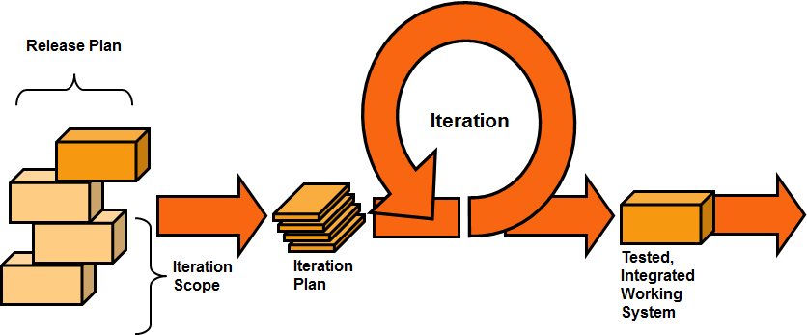

Client Driven Iterative method
feedback from iteration N leads to refinement and adaptation of the requirements and design in iteration N+1
3 week
client

Slide 26
Typical Iterative Development
Small user stories
Usable release after every iteration
Prioritized requirements
Time-boxed iterations
(1-4 weeks)
Customer feedback after every iteration
Each iteration follows all the process activities

Slide 27
How do we get small user stories of a large system?
Decompose the problem
Decompose the solution
Model at multiple levels of abstraction

Slide 28
Models help decompose problems and solution
System model of software
A set of components
Behavior of each component
Interactions between components
Overall behavior in terms of component interactions

Slide 29
Each component is modeled as a system
Point of Sales
Invoice
Product invoice
Service invoice
Payments
Card payments

Slide 30
Agile Software Development
Agile software development is a conceptual framework for software engineering that promotes development iterations throughout the life-cycle of the project.
Software developed during one unit of time is referred to as an iteration, which may last from one to four weeks(sometimes 6 weeks).
Agile methods also emphasize working software as the primary measure of progress.
Agile methodologies that focus on people, communications, the product, and flexibility.

Slide 31
Agile Development Process
Iterative and evolutionary development
Timeboxing
  Set amount of time for iteration
  Adapt future iteration based on the realities
Adaptive planning
Incremental delivery
Agility
More focused on success than sticking with a plan
Working software is valued and considered measure of progress

Slide 32
Existing Agile Methodologies
Methodologies share common principles, but differ in practices
eXtreme Programming (XP)
Scrum
Evolutionary Project Management (Evo)
Agile Unified Process (AUP)
Crystal
Lean Development (LD)
Adaptive Software Development (ASD)
Dynamic System Development Method (DSDM)
Feature Driven Development (FDD)

Slide 33
Agile methods..
Some methods focus on development practices: Extreme Programming (XP)
Other methods focus on the process side: Lean/Kanban, Scrum

Slide 34
eXtreme Programming (XP)
Features
  Frequent Releases: Software is delivered in small, frequent iterations to ensure rapid feedback and adaptability.
  Customer Involvement: Customers are part of the development team, providing real-time feedback and clarifying requirements.
  Simplicity: Developers build only what is needed now, avoiding over-engineering.
  Courage: Teams are encouraged to make bold changes when needed, including refactoring and discarding ineffective practice

Slide 35
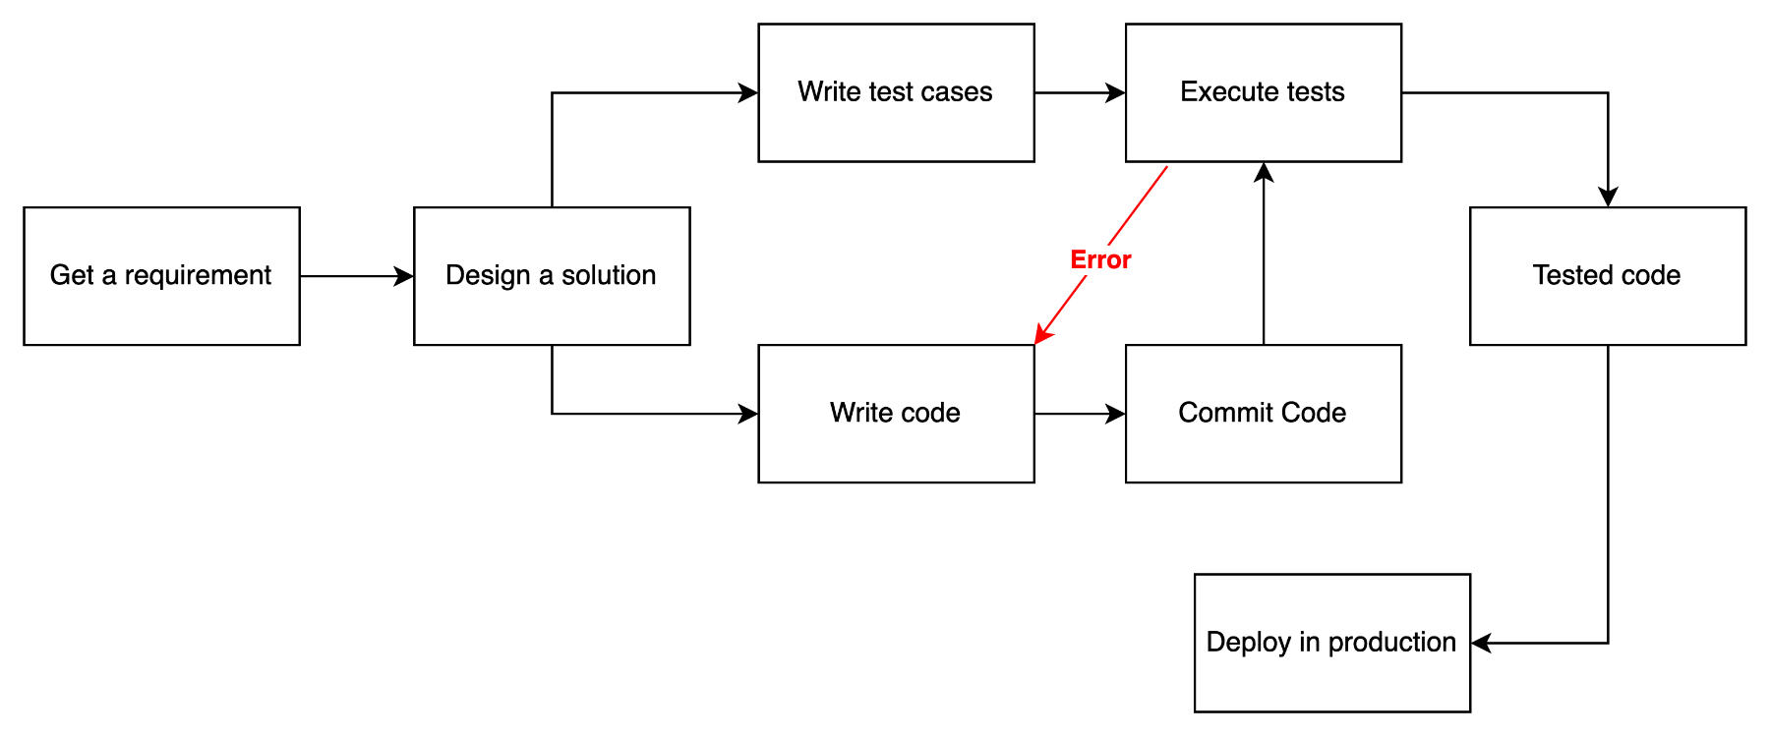
Typical Engineering workflow

Slide 36
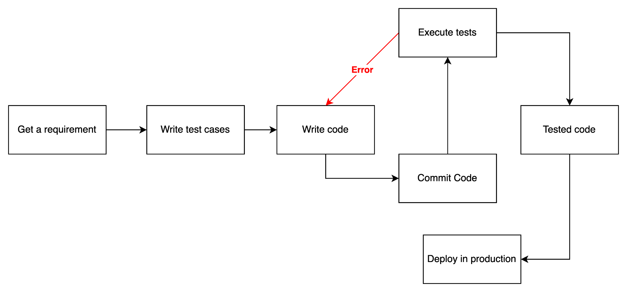
Typical Engineering workflow in XP

Slide 37
Case Study:
Develop a mobile app to track homeless people in India and connect them to shelters, deploy before peak winter.
How would we want to build this if we had all the time and resources in the world?
Write high quality code that is easy to understand
Write good test cases that cover all code and all use cases
Refactor when a simpler way to do something is discovered
Incorporate feedback from customers and users as soon as possible
Ensure all developers know about all parts of the system so that changes can be done quickly and safely
Work at a sustainable pace
XP Philosophy: Do all of these even when you are working with tight deadlines!

Slide 38
XP (The Agile Way)
More code reviews produce better code
More testing produces better software
Quick customer feedback keeps the software high-value
Incremental changes produce better results

Slide 39
Core Practices in XP
Practice | Description
Pair Programming | Two developers work togethers at one workstation – one writes code, other reviews
Test-Driven Development (TDD) | Write tests before writing code to ensure correctness and guide design
Continuous Integration | Code is integrated and tested frequently; often multiple times a day. [use automation tools]
Refactoring | Continuously improve code structure without changing its behaviour.
Collective Code Ownership | Any developer can improve any part of the codebase
Sustainable Pace | Work at a pace that can be sustained indefinitely – no burnout

Slide 40
Commonly used Practices
Test-driven development (TDD)
Specification and design clarity, fewer bugs, faster feedback
Pair programming
Real-time code review, knowledge sharing, better design, team cohesion
Continuous Integration
Faster delivery, lower integration time, higher code quality.

Slide 41
Test Driven Development (TDD)
Write tests before writing code.
Each test defines a small, specific behavior the system should have.
Follow the Red-Green-Refactor cycle
Red: Write a failing test.
Green: Write just enough code to pass the test.
Refactor: Clean up code while keeping tests green.
Test-driven development
Write Test
↓
Run Test (Fail)
↓
Write Code (Pass)
↓
Run All Tests
↓
Refactor Code
↺
Repeat

Slide 42
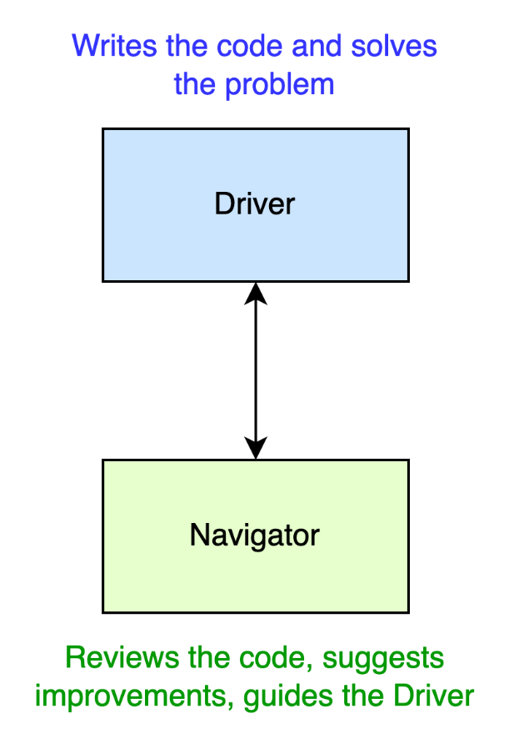
Pair Programming
Two developers work together at one workstation.
Driver: Writes the code, solves the problem
Navigator: Reviews code, does unit testing, thinks ahead, suggests improvements, guides the driver
Roles switch frequently
Pair programming

Slide 43
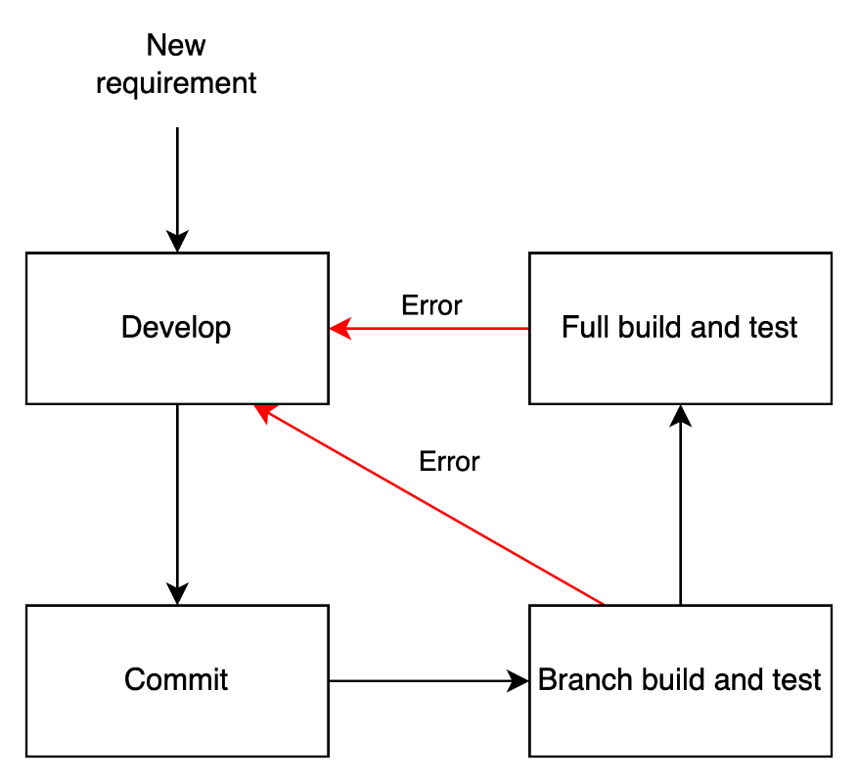
Continuous Integration
Developers integrate code frequently (often daily or multiple times a day).
Each integration is verified by an automated build and test suite.
Detects integration issues early, reducing debugging time.
Continuous integration

Slide 44
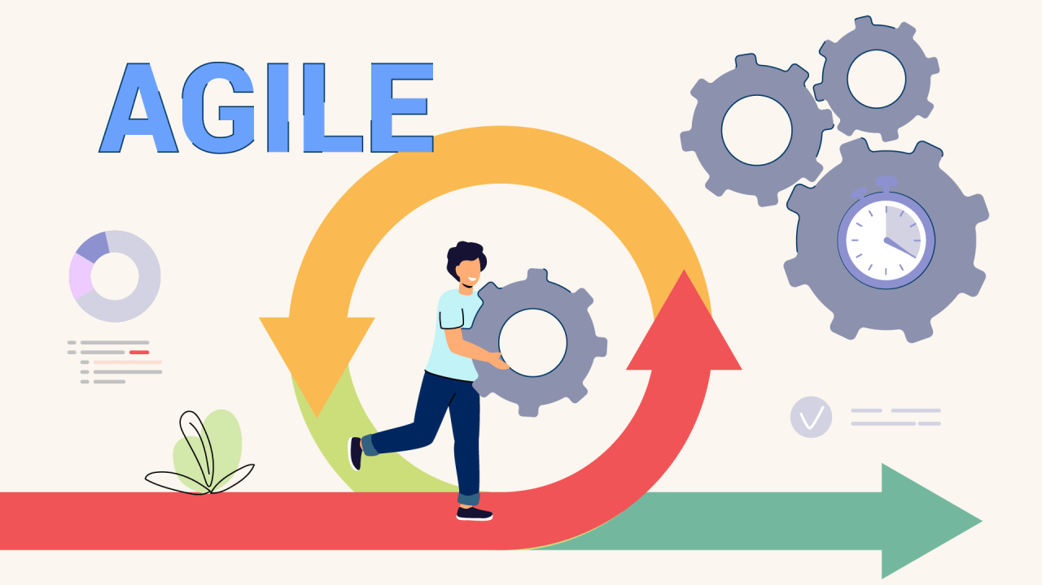
Enter Agile

Slide 45
Agile methods with focus on Process
These focus on reducing bottlenecks and adapt to changing priorities of users
Lean
  emphasizes eliminating waste, delivering value quickly, and continuous improvement
Kanban
  is a visual workflow management method that uses boards and cards to track tasks, limit work-in-progress, and optimize throughput
Scrum
  Organizes work into time-boxed sprints, enabling teams to deliver incremental value through collaboration and continuous improvement

Slide 46
Lean/Kanban
Lean/Kanban process guidelines emphasize
  visualizing work,
  limiting tasks in progress,
  and continuously improving flow
  to maximize efficiency and minimize waste

Slide 47
Lean/Kanban – Reduce Waste
Visualize the work
Use Kanban boards to make all tasks and their status visible (like “To Do,” “In Progress,” and “Done”).
Eliminate Waste
Set WIP limits to avoid overload and encourage focus
Manage flow
Track and optimize the flow of work to ensure smooth delivery and identify bottlenecks
Implement Feedback Loops
Have regular reviews and retrospectives to assess performance and adjust processes
Build Quality In
Remove non-value-adding activities like redundant code, delays, and unnecessary documentation
Limit work in progress (WIP)
Integrate testing and validation throught development to prevent defects early.

Slide 48
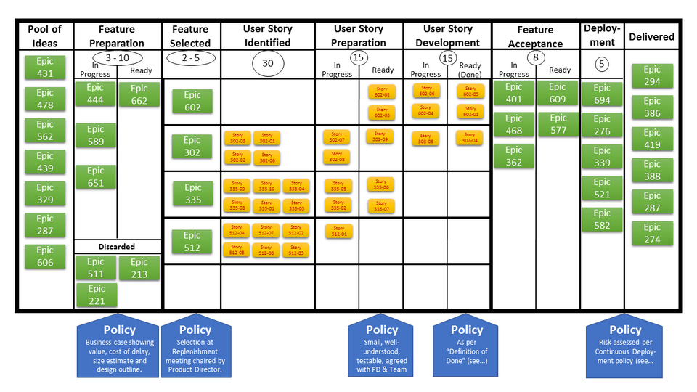
A Sample Kanban chart
Image Credit: Andy Carmichael

Slide 49
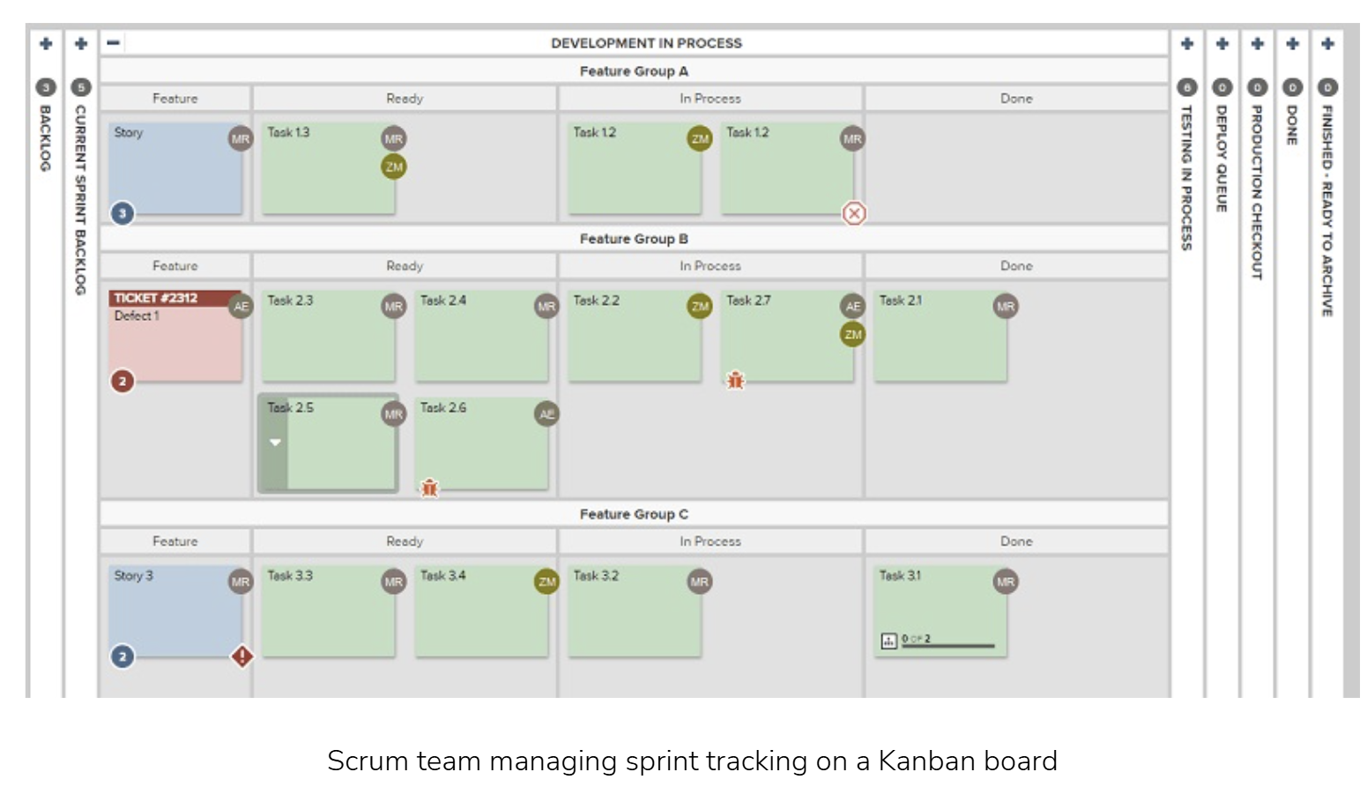
Example: Kanban Board
https://www.planview.com/se/resources/guide/kanban-project-management-virtual-teams/kanban-board-examples/

Slide 50
Scrum
Methodology suited especially for complex projects requiring adaptability and stakeholder engagement.
  Change is inevitable
  Customer focused. Deliver what customer wants now.

Slide 51
SCRUM- Empirical Control
Empiricism
Prioritize and rank user stories aggressively during Sprint Planning
Self-Management
Develop in Sprints with transparent progress tracked on Scrum Boards
Continuous improvement
Use Sprint Reviews and Retrospectives to adapt and improve every cycle
Just-enough planning
Scrum is built on transparency, inspection and adaption
Short, time-boxed iterations
Teams decide how best to accomplish their task

Slide 52
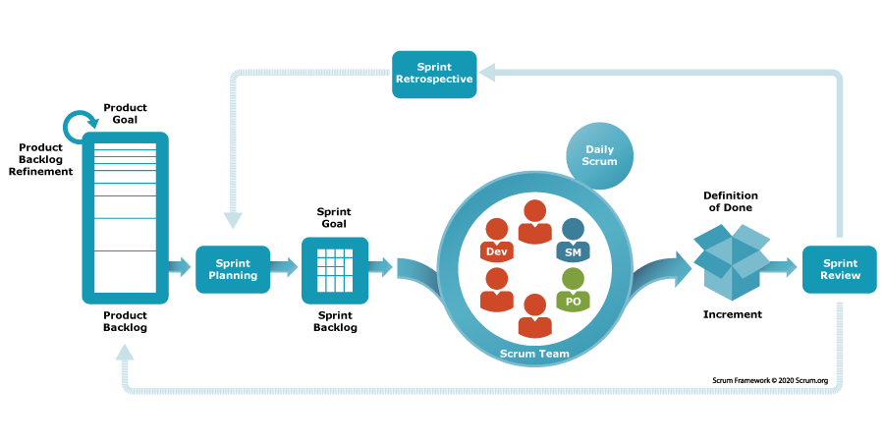
SCRUM Process Overview

Slide 53
3 Roles, 3 Artefacts, 5 Events
Roles
Product Owner
Scrum Master
Development Team
Artefacts
Product backlog
Sprint backlog
Product increment
Events
Sprint
Sprint planning
Daily scrum
Sprint review
Sprint retrospective

Slide 54
SCRUM Roles
Product Owner
Owns the product backlog.
Prioritizes features based on business value and customer needs.
Scrum Master
Facilitates Scrum practices.
Removes impediments and shields the team from distractions.
Developers
Cross-functional team members who build the product.
Responsible for delivering a usable increment each sprint

Slide 55
SCRUM Artefacts
Product Backlog
Ordered list of everything needed in the product.
Continuously refined by the Product Owner.
Sprint Backlog
Selected items from the product backlog for the current sprint.
Includes a plan for delivering the increment.
Increment
The sum of all completed product backlog items during a sprint.
Must be in usable condition and meet the Definition of Done.

Slide 56
SCRUM Events
Event | Purpose
Sprint | Time-boxed iteration (1-4 weeks) to deliver a product increment
Sprint Planning | Define sprint goals and select backlog items to work on
Daily Scrum | 15-minute stand-up to synchronize and plan the next 24 hours.
Sprint Review | Present the increment to the stakeholders and gather feedback
Sprint Retrospective | Reflect on the sprint and identify improvements for the next one

Slide 57
Quick Quiz – CS2-2
Submit your response using this form
https://

Slide 58
Example 1: Agile in E-Commerce – Flipkart’s Checkout Optimization
Challenge:
Flipkart’s checkout abandonment rate was rising. In a Waterfall setup, UI changes would take months to deploy.
Agile Solution:
Product team used real-time analytics to identify friction points.
Within one sprint, they A/B tested two new checkout flows.
The winning flow was deployed in under 2 weeks.
Impact:
Checkout completion rate improved by 15%
Agile enabled rapid experimentation and user-centric design
Discussion Prompt:
How would this scenario play out in a Waterfall model?

Slide 59
Example 2: Agile in Healthcare; Apollo Hospitals’ Patient Flow Management
Challenge:
Long patient wait times and inefficient resource allocation.
Agile Solution:
Cross-functional teams (IT, nursing, admin) collaborated in sprints.
Real-time dashboards tracked wait times and bottlenecks.
Staff schedules and room assignments were adjusted weekly.
Impact:
Wait times reduced by 20%
Staff satisfaction improved due to better workload distribution
Discussion Prompt:
What Agile principles helped Apollo respond faster than a traditional model?

Slide 60
Agile for Very Large System Development
The organization uses a mix of multiple agile methods, along with organization-specific tweaks - Scrum usually is the base process and many XP practices used during Sprints.
In Agile, key is to break down large problems/solutions into smaller ones, iteratively.

Slide 61
Agile for Very Large System Development
Scaled Frameworks Enable Coordination Across Teams
  Large projects use frameworks like SAFe (Scaled Agile Framework), LeSS (Large-Scale Scrum), or Spotify Model to synchronize multiple Agile teams.
  These frameworks introduce roles (e.g., Release Train Engineer, Tribe Lead) and ceremonies (e.g., Program Increment Planning – PI Planning) to align goals and dependencies across units.
Modular Architecture Supports Parallel Development
  Agile promotes decomposing large systems into smaller, loosely coupled modules.
  Each module is owned by a dedicated team that can iterate independently, reducing bottlenecks and enabling faster delivery.
Incremental Delivery with Cross-Team Integration
  Agile in large projects emphasizes frequent integration and testing across teams to ensure compatibility and system-wide functionality.
  Continuous integration pipelines and shared backlogs help maintain cohesion while allowing distributed teams to move quickly.
More Later

Slide 62
Case Study
Read about TechNova and their experience with iterative development
Team Alpha uses a long iteration (8 week) cycle, Team Beta uses a short iteration (1 week) cycle.

Slide 63
Technova Case Study
Submit your response using this form

Slide 64
Session Summary
(short cycle) Iterative development is the preferred development process for most software projects
Decomposing the problems and solutions, and modelling at different levels of abstraction are very important steps for large software systems
Organizations use a mix of agile methods designed to suit their needs.
TDD and CI/CD are key to successful agile teams
Different Agile methods optimize for different properties (XP for development practices, Scrum and kanban for process management,).

Slide 65


Questions?

